Slide 1
NLP 2
Mina Naghshnejad

Slide 2
Language generation (NLG)
The process of producing meaningful phrases and sentences in the form of natural language.
Can be used to produce long form content for organizations to automate custom reports, as well as produce custom content for a web or mobile application.
It can also be used to generate short blurbs of text in interactive conversations (a chatbot) which might even be read out by a text-to-speech system.

Slide 3
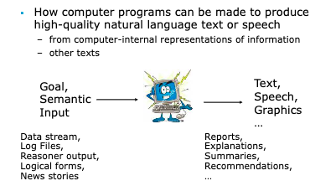

Slide 4
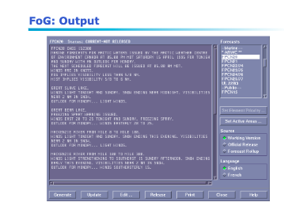
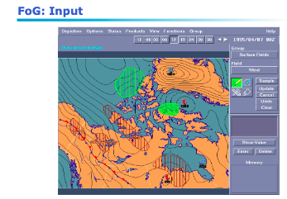
Example:

Slide 5
NLG is all about making choices:
Content to be included/omitted
Organization of content into coherent structure
Style (formality, opinion, genre, personality...)
Packaging into sentences
Syntactic constructions:
How to refer to entities (referring expression generation)
What words to use (lexical choice)

Slide 6
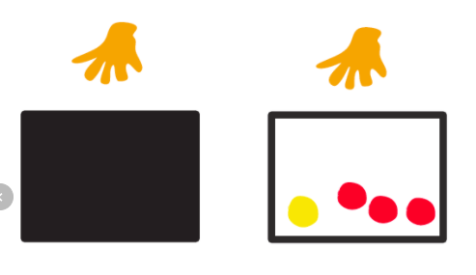
Analogy from classic probability
We take a ball from a box and then check its color.
What is the probability that the ball is red?
Pr(ball=red)=
|red balls|/|all balls in the box|

Slide 7

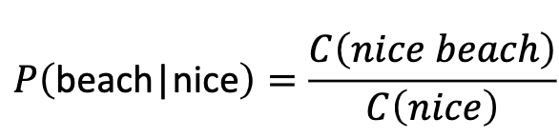
Language model:
the task of predicting the next word, given the words so far
Goal: estimate the probability of a word sequence
Earlier models (N-gram models):
Probability is conditioned on a window of (n-1) previous words
Estimate the probability based on the training data

Slide 8
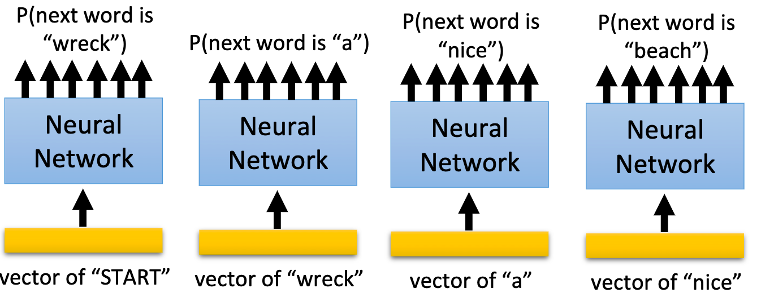
NN-based language model
P(“wreck a nice beach”) = P(wreck|START)P(a|wreck)P(nice|a)P(beach|nice)

Slide 9
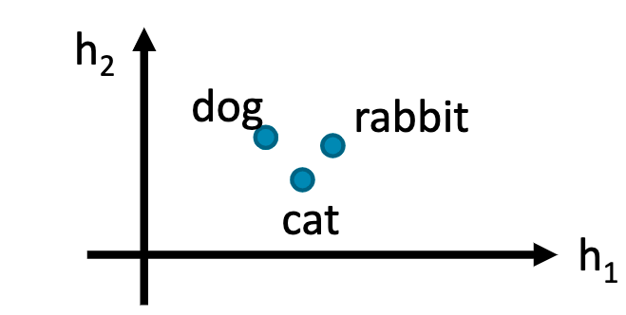
NN-based language model
The input layer (or hidden layer) of the related words are close If P(jump|dog) is large, P(jump|cat) increase accordingly(even there is not “... cat jump ...” in the data)

Slide 10
Deep learning models
Neural networks
Recurrent neural networks (with attention)
Convolutional neural networks
Transformers

Slide 11
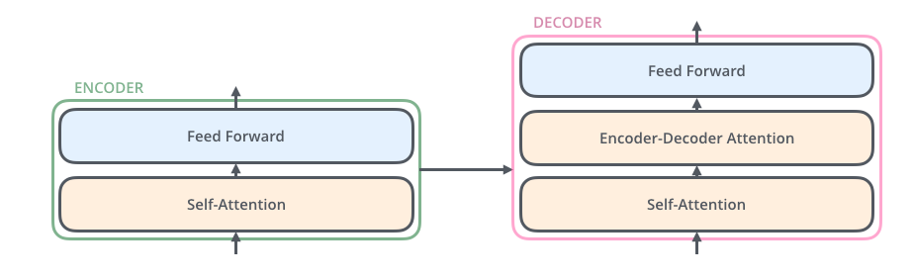
Transformers:
Trained on huge amount of training data
stacked layer of deep neural networks
self attention
Trained on genreral corpora to facilitate fine tuning on various tasks

Slide 12
Transfer learning
Pretraining: Training the model on large corpora
Fine-tuning: Tune the model on smaller dataset (B) which is not exactly the same as (A)
A
B

Slide 13
GPT-2 Transformer language model(OPEN-AI)
GPT-2 is a large transformer-based language model with 1.5 billion parameters, trained on a dataset of
40GB of Internet text.
Trained on Reddit pages:
We created a new dataset which emphasizes diversity of content, by scraping content from the Internet. In order to preserve document quality, we used only pages which have been curated/filtered by humans—specifically, we used outbound links from Reddit which received at least 3 karma. This can be thought of as a heuristic indicator for whether other users found the link interesting (whether educational or funny), leading to higher data quality than other similar datasets, such as CommonCrawl of 8 million web pages. GPT-2 is trained with a simple objective: predict the next word, given all of the previous words within some text.

Slide 14
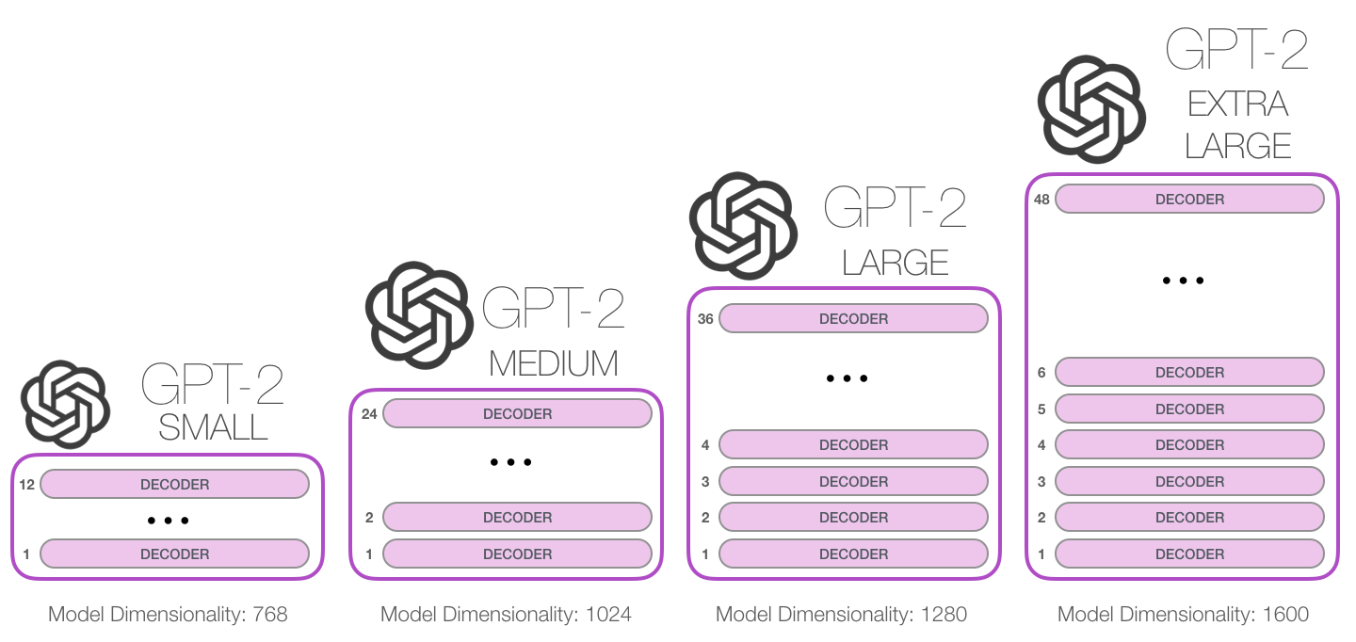

Slide 15

DialoGPT (MICROSOFT)
Dialog model fine tuned from GPT2
The model is trained on 147M multi-turn dialogue from Reddit discussion thread. The largest model can be trained in several hours on a 8 V100 machines (however this is not required), with distributed training and FP16 option.

Slide 16
Chatbots
Business Insider experts predict that by 2020, 80% of enterprises will use chatbots.
According to Lauren Foye, by 2022, banks can automate up to 90% of their customer interaction using chatbots.
A survey conducted by Spiceworks showed that 40% of large companies employing more than 500 people plan to implement one or more intelligent assistant or AI-based chat robot over corporate mobile devices in 2019.

Slide 17
Downstream language generation tasks
We focus on two downstream language generation tasks:
Essay writing
Chatbots

Slide 18
Essay writing

Slide 19
Chat bots
Dialog datasets are small and it’s hard to learn enough about language and common-sense from them to be able to generate fluent and relevant responses.
start by pretraining a language model on a very large corpus of text to be able to generate long stretches of contiguous coherent text,
fine-tune this language model to adapt it to our end-task: dialog

Slide 20
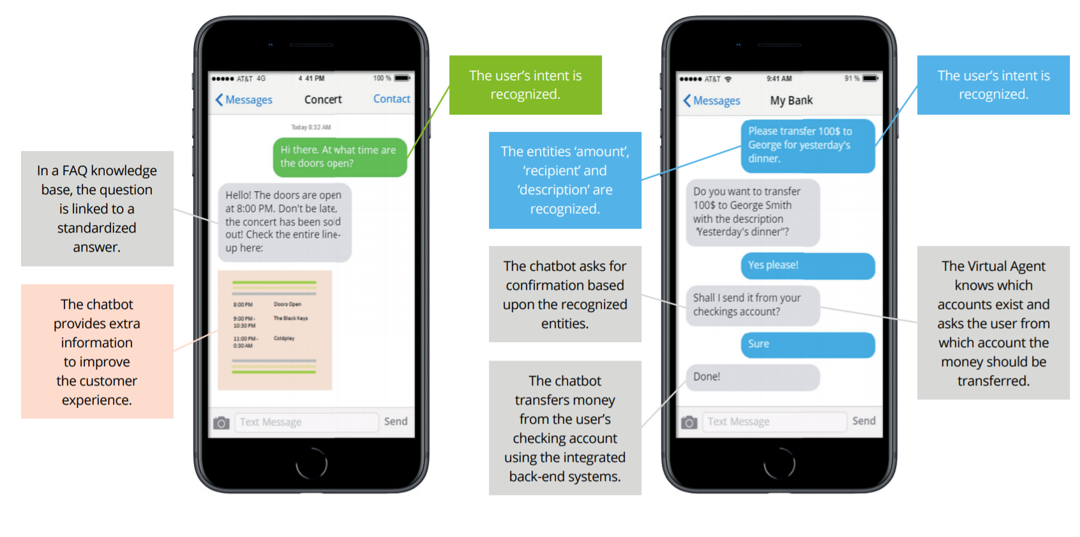

Slide 21
Chatbot Characteristics
Intent Recognition Ability to “guess” what the user is requesting, even if phrased unexpectedly. Good intent recognition is vital if you don’t want to annoy your users.
Dialog Management Go beyond simple Q&A and enable your Chatbot to have complex and meaningful conversations with the user.
Humanization Users get more engaged in conversation if a Chatbot acts more humanlike. Some Chatbots are able to detect and show emotions.
Interaction Channels How will users interact with your Chatbot? Choose a platform that connects easily with your webchat, app, social media platform or voice interface.
Task Automation Capability Does your Chatbot need to perform tasks for users? Make sure it has enough dialog capabilities and that it can connect to your back-end systems
Reporting & Monitoring Are your customers being helped? Are they happy? Does your contact center get less calls? Choose a Chatbot platform that tells you how it’s performing.
Ease of Implementation Some platforms require custom software development, while others allow business users to configure the Chatbot themselves.
Security & Compliance Do you have extra security requirements? Or do you need to be compliant with audit regulations? Security and logging capabilities vary amongst
Notes:
There is a big variety in Chatbot development platforms. Below are a number of characteristics that should be taken into account when choosing the suitable platform to implement with your Chatbot.

